Slide 1
Lecture 13 SIMD, VECTOR and SSE Courtesy of A. Shrivastava (ASU) & Tack-Don Han (Yonsei)
Computer Architecture-Module5
Department of Computer Science
Kyoungwoo Lee

Slide 2
Agenda
Flynn’s Taxonomy
SIMD/Vector Processors
SSE (Streaming SIMD Extensions) Processors

Slide 3
Flynn’s Taxonomy
SIMD/Vector/SSE

Slide 4
Flynn’s Taxonomy
SISD : Single Instruction operates on single data
Example : Processors like MIPS, Intel Pentium 4, etc.
SIMD : Single Instruction operates on multiple data
Vector processors
MISD : Multiple instruction operates on single data
No example as of now
MIMD : Multiple instruction operates on multiple data
Multicore, Multithreaded processors (Intel Xeon Clovertown)
Inst. Data | Single | Multiple
Single | SISD | SIMD
Multiple | MISD | MIMD

Slide 5
SIMD and Vector Processors
SIMD/Vector/SSE

Slide 6
SIMD Advantages & Disadvantages
Advantages:
Reduces cost over control unit over dozens of executions
Reduces program memory
SIMD may need only one copy of the code that is being simultaneously executed, while message passing MIMD may require multiple copies
Disadvantages:
SIMD is best suited for highly regular memory access
Best suited for for loops but weak for switch cases

Slide 7
Scalar vs. Vector Processors
Scalar Processor
Vector Processor
R1
R2
VR1
VR2
+
+
R3
VR3
add R3, R1, R2
add VR3, VR1, VR2

Slide 8
Vectorizable Loops
Loop in which one iteration is not dependent on the other is vectorizable
Only vectorizable loops can be efficiently executed by vector processors
Example
for i : 0 - 100 c[i] = ( a[i] + b[i] ) / 10

Slide 9
Vector Processor Requirements
Load/store of vector values
Vector Registers
Operate on Vectors of different lengths
Vector length register or strip-mining
Elements can be stored apart from each other
Vector Stride Register

Slide 10
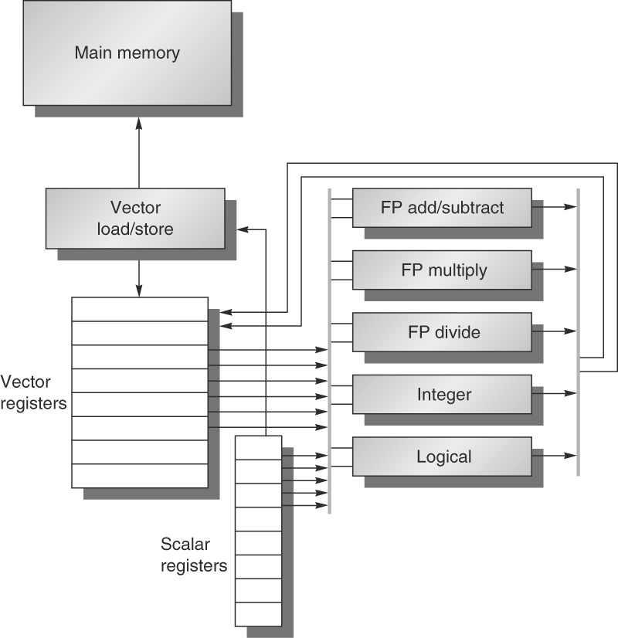
VMIPS Vector architecture

Slide 11
Vector Processing Example
SIMD/Vector/SSE

Slide 12
Scalar Example DAXPY
Double precision a times X Plus Y ()
Scalar MIPS code for DAXPY
L.D F0, a ;load scalar a
DADDIU R4, Rx, #512 ;last address
Loop: L.D F2, 0(Rx) ;load X[i]
MUL.D F2, F2, F0 ;a * X[i]
L.D F4, 0(Ry) ;load Y[i]
ADD.D F4, F4, F2 ;a * X[i] + y[i]
S.D F4, 0(Ry) ;store into Y[i]
DADDIU Rx, Rx, #8 ;Increment X index
DADDIU Ry, Ry, #8 ;Increment Y index
DSUBU R20, R4, Rx ;compute bound
BNEZ R20, Loop ;loop
Total 576 (64*9) dynamic instructions!

Slide 13
Vector Example DAXPY
ADDVV.D: add two vectors of doubles
ADDVS.D: add vector to a scalar
LV/SV: vector load and vector store from address
Example: DAXPY
Requires 6 instructions vs. almost 600 for MIPS
L.D F0,a ; load scalar a
LV V1,Rx ; load vector X
MULVS.D V2,V1,F0 ; vector-scalar multiply
LV V3,Ry ; load vector Y
ADDVV V4,V2,V3 ; add
SV Ry,V4 ; store the result

Slide 14
Memory is a PROBLEM!
Vector processor requires highly regular data access by the program
There should a support from memory as well
For a single memory with only one bank, the time taken to load different vector values will be more than the operating on the data
Solution can be memory banking but,
Memory can still become a bottleneck!
if compute/memory operation balance is not maintained
Data is not mapped appropriately to the memory banks

Slide 15
Scatter-Gather
What if data is not stored in a strided manner in the memory?
Use indirect access called Scatter-Gather.
Scatter-Gather operation are often implemented in Hardware to handle sparse matrices
Example (K and M are index vectors that are added to base register to generate the address)
for (i =o; i<n ; i++) A[K[i]] = A[K[i]] + C[M[i]]

Slide 16
Scatter-Gather
Use of LVI/SVI instructions : load/store vector indices/gather
LV Vk, Rk ;load K
LVI Va, (Ra+Vk) ;load A[K[]]
LV Vm, Rm ;load M
LVI Vc, (Rc+Vm) ;load C[M[]]
ADDVV.D Va, Va, Vc ;Add A[K[]], C[M[]]
SVI (Ra+Vk), Va ;store A[K[]]

Slide 17
Streaming SIMD Extensions (SSE)
SIMD/Vector/SSE

Slide 18
Streaming SIMD Extensions-SSE
Adds eight 128-bit registers
Allows SIMD operations on packed single-precision floating-point numbers
Most SSE instructions require 16-aligned addresses

Slide 19
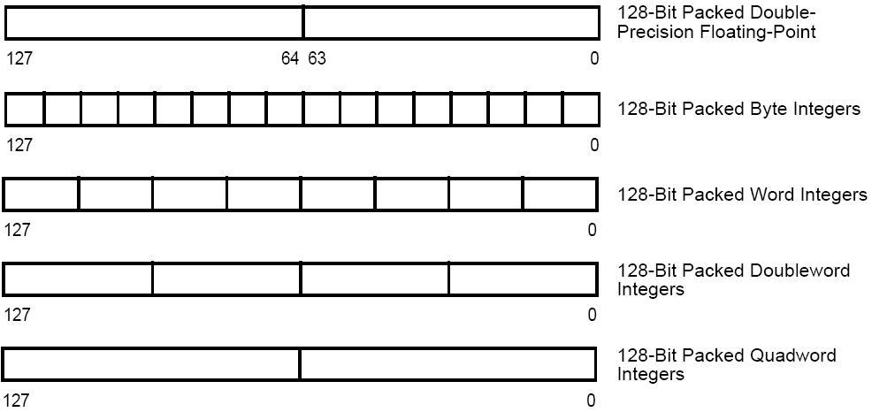
SSE features

Slide 20
SSE features
Add eight 128-bit data registers (XMM registers) in non-64-bit modes; sixteen XMM registers are available in 64-bit mode.
32-bit MXCSR register (control and status)
Add a new data type: 128-bit packed single-precision floating-point (4 FP numbers.)
Instruction to perform SIMD operations on 128-bit packed single-precision FP and additional 64-bit SIMD integer operations.
Instructions that explicitly prefetch data, control data cacheability and ordering of store

Slide 21
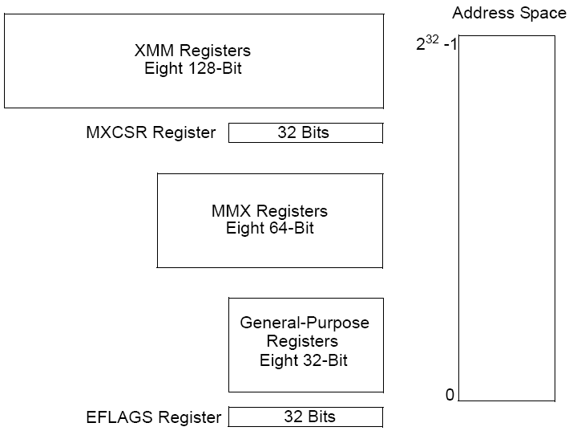
SSE programming environment
XMM0
|
XMM7
MM0
|
MM7
EAX, EBX, ECX, EDX
EBP, ESI, EDI, ESP

Slide 22
Assignments
Question) Which of the following code is not vectorizable?
(Note: the code is present inside a for loop)
(1) c[i] =a[i]+(b[i]*100);
(2) c[i] = c[i] + 2*c[i];
(3) c[2*i] = a[i] + b[3*i];
(4) c[i] = a[i-2] + b[i-1]
(5) c[i] = a[i]=b[i]; e[i] = f[i]+d[i];

Slide 23
Summary
Flynn’s Taxonomy – SISD, MISD, SIMD, MIMD
Vector Processing and Streaming SIMD Extension
Next: Multithreading

